Slide 1
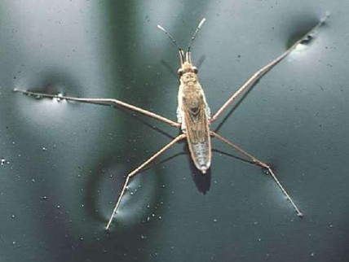
How is it possible for insects to walk on water?
I think I already know that________.

Slide 2

Focus Question 1
What will happen when you put a drop of water on wax paper, printer paper or filter paper?
Turn and Talk:
I predict _______because _______.
Record in your notebook

Slide 3
Put few drops of water on a piece of wax paper, printer paper and filter paper
Record your observation in your notebook.
Was your prediction correct?

Slide 4

Put few drops of water on a piece of wax paper, printer paper and filter paper
Do it!
Observe
Record
Was your prediction correct?

Slide 5
Making Sense: Group Talk
I think_______________, because _____________.
I claim ______________.
My evidence is ___________________.
I agree/disagree with ________________.
What I am hearing is ____________________.
The reason I think this way is__________________.
Can you say more about that?

Slide 6
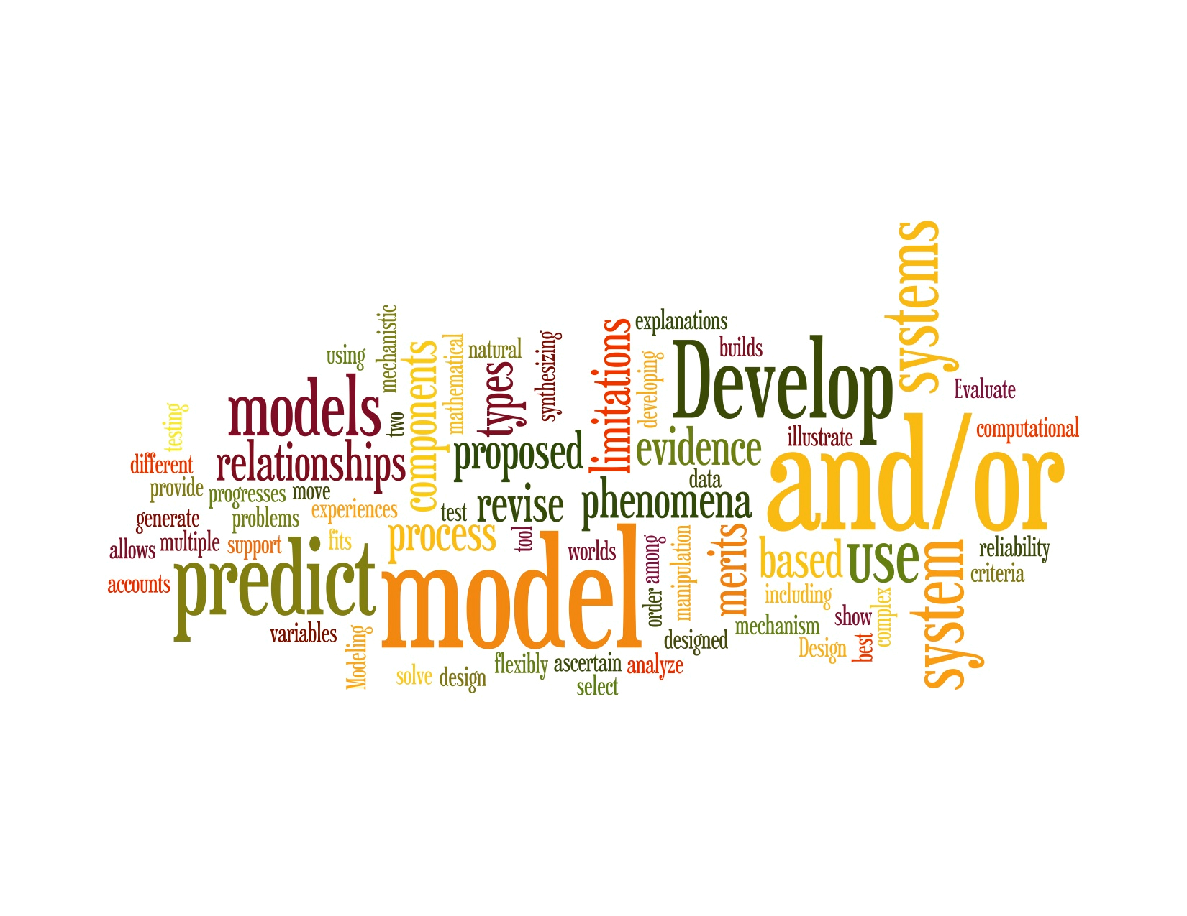

Slide 7
Draw a model
Using the poster paper draw a model at microscopic level.
Include written explanations about
  Observations
  Changes before and after
  Polarity Forces using arrows
  Show Inter Molecular Forces

Slide 8
Focus Question 2
What will happen when you put a drop of milk on wax paper, printer paper or filter paper?
Turn and Talk:
I predict _______because _______.
Record in your notebook

Slide 9
Put few drops of milk on a piece of wax paper, printer paper and filter paper
Do it!
Observe
Record
Was your prediction correct?

Slide 10
Making Sense: Group Talk
I think_______________, because _____________.
I claim ______________.
My evidence is ___________________.
I agree/disagree with ________________.
What I am hearing is ____________________.
The reason I think this way is__________________.
Can you say more about that?

Slide 11
Revise your model
Add or make changes to your poster
Make sure to include the intermolecular forces and Polar/nonpolar interactions

Slide 12
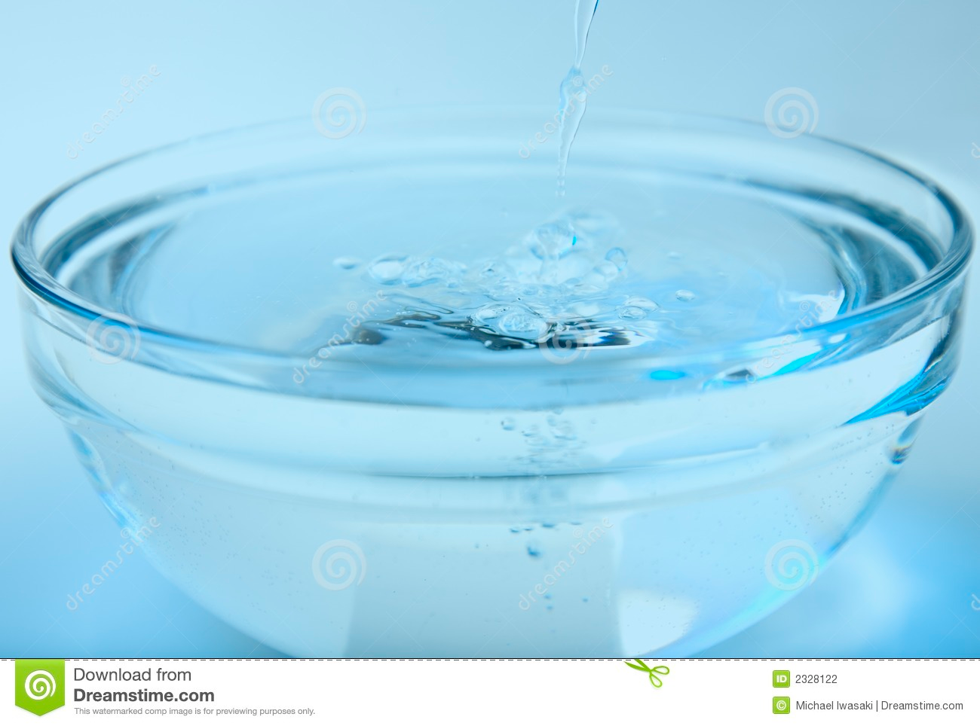
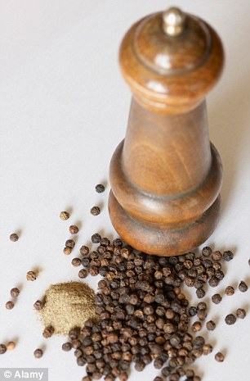
Focus Question 3
What will happen if you sprinkle some black pepper on water?
Turn and Talk:
I predict _______because _______.
Record in your notebook

Slide 13
Put some black pepper on water
Do it!
Observe
Record
Was your prediction correct?

Slide 14
Take a cotton bud and soak in soap.
Touch this soaked cotton bud in the center of the water bowl.
What Happened?
Record in your notebook.

Slide 15
Making Sense: Group Talk
I think_______________, because _____________.
I claim ______________.
My evidence is ___________________.
I agree/disagree with ________________.
What I am hearing is ____________________.
The reason I think this way is__________________.
Explain your reasoning___________

Slide 16
Revise your model with new
Make changes or add to your model
Observable and unobservable phenomena
Changes
Intermolecular Forces using arrows
Written explanations of concepts

Slide 17
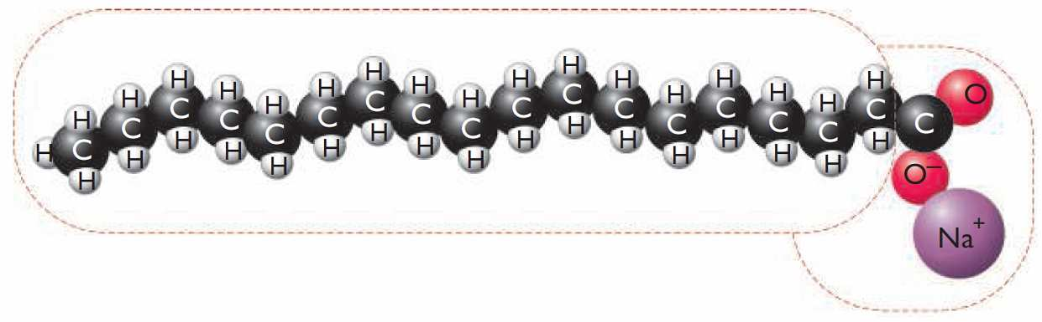
Soap molecule

Slide 18
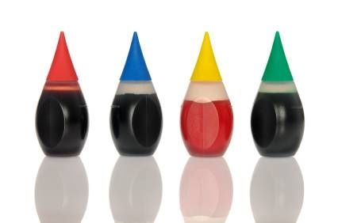
Focus Question 4
What will happen if you add some food coloring to milk?
Turn and Talk:
I predict _______because _______.
Record in your notebook

Slide 19
Put some food color in milk
Do it!
Observe
Record
Was your prediction correct?

Slide 20
Take a cotton bud and soak in soap.
Put this soaked cotton bud in the center of the milk bowl.
What Happened?
Record in your notebook.

Slide 21
Making Sense: Group Talk
I think_______________, because _____________.
I claim ______________.
My evidence is ___________________.
I agree/disagree with ________________.
What I am hearing is ____________________.
The reason I think this way is__________________.
Explain your reasoning___________

Slide 22
Revise your model with new
Make changes or add to your model
Observable and unobservable phenomena
Changes
Intermolecular Forces using arrows
Written explanations of concepts

Slide 23
Focus Question 5
What will happen if you add some food coloring to water?
Turn and Talk:
I predict _______because _______.
Record in your notebook

Slide 24
Put some food color in water
Do it!
Observe
Record
Was your prediction correct?

Slide 25
Take a cotton bud and soak in soap.
Touch this soaked cotton bud in the center of the water bowl.
What Happened?
Record in your notebook.

Slide 26
Making Sense: Group Talk
I think_______________, because _____________.
I claim ______________.
My evidence is ___________________.
I agree/disagree with ________________.
What I am hearing is ____________________.
The reason I think this way is__________________.
Explain your reasoning___________

Slide 27
Revise your model with new
Make changes or add to your model
Observable and unobservable phenomena
Changes
Intermolecular Forces using arrows
Written explanations of concepts

Slide 28
Support your model
Write explanations describing the phenomenon.
Every observation must include a supporting explanation

Slide 29
Sharing Models
Go to the next group
Discuss their model in your group
Give feedback to the other group using sticky notes.
  What did you mean by _________________? ( Clarification)
  Can you elaborate on how the ____________(observation) supports the explanation?
  I want to expand on your explanation about _____________(build on)

Slide 30
Sharing Models
Go back to your table
Read the feedback
Think about one thing you would change
Line of Learning:
I used to think_________________, and now I think ______________.

Slide 31
Presentation
Final revision of the model with content checklist:
  What are intermolecular forces?
  Why are water molecules attracted to each other or certain types of molecules?
  Adhesion, cohesion
  Polar and nonpolar interactions
  Interaction with soap

Slide 32
