Slide 1
Nanoparticles and Blood Coagulation
Kick Starting Coagulation with Silica Nanoparticles
Presentation by: Megan Nesland
Mentor: Tracy Chuong
University of California, Santa Barbara
Department of Chemistry and Biochemistry
Notes:
Teacher Notes: This presentation covers 1 novel application of nanotechnology, the use of nanoparticles to initiate blood coagulation in internal injuries following some form of trauma.

Slide 2
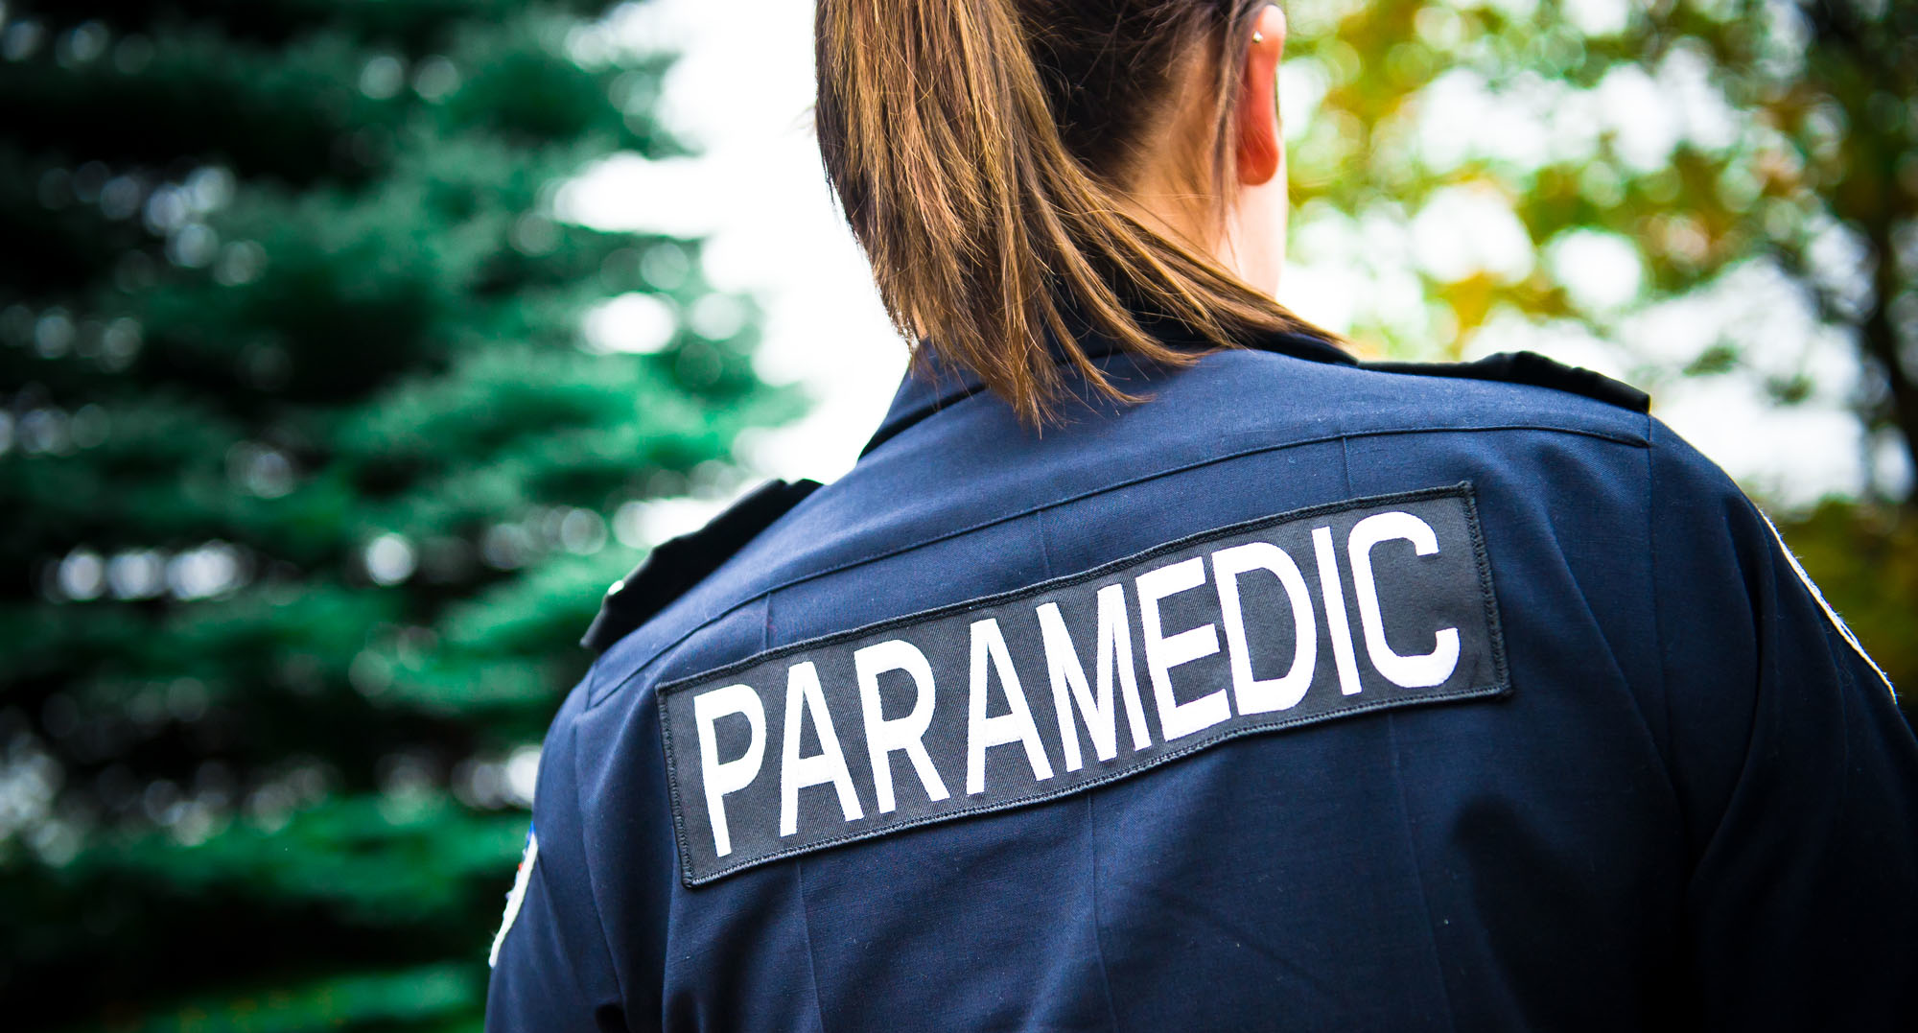
The Big Picture
Trauma injury accounts for 30% of all life years lost in the U.S.
$406 billion a year, including both health care costs and lost productivity
Cause of Death:
  #1 for age group 1-44, or 47% of all deaths in this age range
  #3 as leading cause of death overall, across all age groups
http://www.nationaltraumainstitute.org/home/trauma_statistics.html
Notes:
Teacher Notes: Trauma causes enormous losses every year, both in terms of life and in money. For young people, trauma is the number 1 cause of death and remains a significant cause across all age groups. Therefore, it is a widespread problem for which a solution would be both a significant benefit to the public and a potential money-maker for pharmaceutical companies. In fact, much of the research in this area is funded by the military, who have obvious vested interest in curbing the consequences of traumatic events.

Slide 3
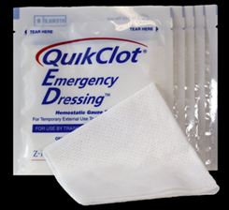
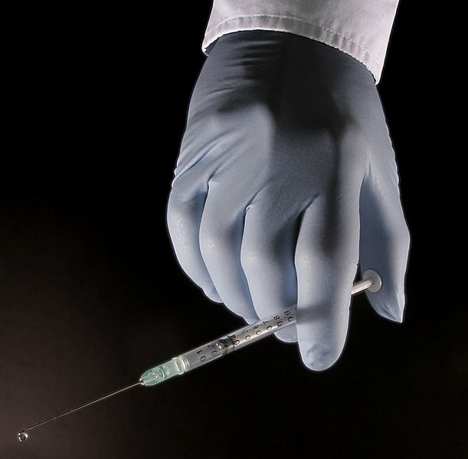
The Big Picture
http://www.z-medica.com/firstResponder/Home.aspx
http://commons.wikimedia.org/wiki/File:Syringe_Glove_01.jpg
Notes:
Teacher Notes: Currently, adequate solutions exist for surface wounds caused by trauma. Products such as QuikClot, developed at UCSB with funding from the Department of Defense, can be applied to the site if a wound and use a clay (Kaolinite) to speed clotting. This clay has high surface area, much like nanoparticles, and negative charge on its surface. This negative charge, which we will talk more about later, is essential to initiating and speeding clotting.
Quikclot works well for external injuries, but is useless for internal bleeding. Medical personnel, from the military to civilian paramedics,
QuikClot Explanation: https://www.youtube.com/watch?v=G_xhJuduBE0

Slide 4
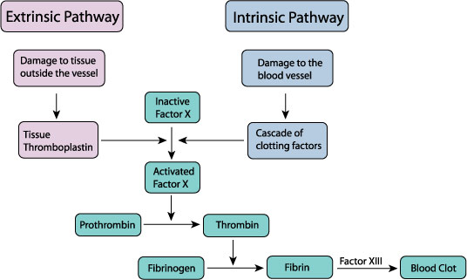
Blood Coagulation 101
http://www.biosbcc.net/doohan/sample/htm/Hemostasis.htm
Notes:
To design this product, researchers must first understand the process by which blood clots naturally. This is called the “Coagulation Cascade” and involves a series of chemical reactions, each one causing the following reaction to start like dominos falling one by one.
Video 1: https://www.youtube.com/watch?v=--bZUeb83uU
(general overview of coagulation)
Video 2: https://www.youtube.com/watch?v=cy3a__OOa2M
(more in-depth) One or both of these videos could be used
The specifics of this series of reactions are not super important to understand at this point, but it is important to know that this whole process is dependent upon the presence of a negatively charged surface (remember Kaolin’s negative surface?) So where does this negative surface typically come from?

Slide 5
Blood Coagulation 101
Notes:
Blood platelets, which travel through our blood stream all the time, have this all-important negative surface that causes the Coagulation Cascade to happen. Under normal conditions, this negative surface is enough to initiate clotting. However, following a traumatic event, a person’s body may in a state of shock, making it more difficult for this process to start. The blood platelets alone may not be enough for clotting to occur.

Slide 6
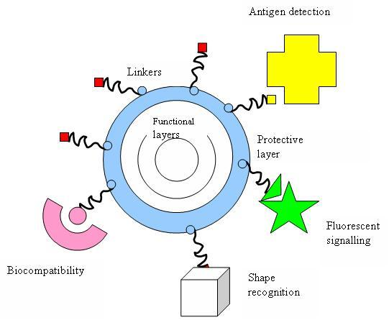
Why NanoParticles?
Surface Area
Potential for customization
Biocompatible
Notes:
This is where nanoparticles come in. Nanoparticles are useful for many reasons, one of which being that they are, as you have learned, extremely small. Hopefully you have seen by now that extremely small things have extremely high surface area. We will talk more about how that surface area helps in just a moment.
Nanoparticles are also helpful because they are customizable- you can attach all kinds of molecules to a nanoparticle to design it for a specific purpose. For example, I could attach something to a nanoparticle that will make it glow under UV light, or attach a molecule that will help it recognize a specific protein in the body. For this reason, nanoparticles are being explored for a whole host of biomedical uses, some of which you may chose to investigate later.
Lastly, nanoparticles can be biocompatible, depending on what they are made of, so they have the potential to cause fewer problems after the blood clotting has finished.

Slide 7
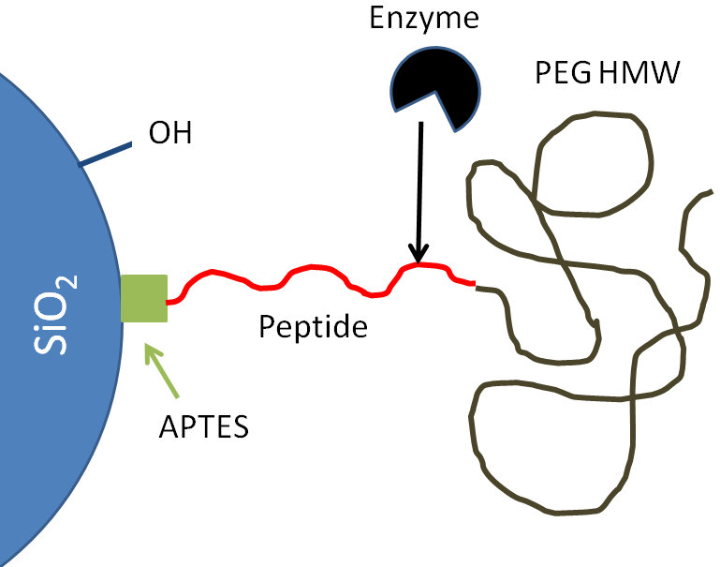
How do SNP (Silica Nanoparticles) Work?
Wound site
Diagram courtesy of Anna May and Damien Kudela
Notes:
For this application, researchers at UCSB have designed a nanoparticle with several important components. First, the key to the particle is silica, or SiO_{2.} This molecule, it may or may not surprise you, is a component of many naturally occurring clays (remember that kaolin) and tends to carry a negative charge.
Secondly, there is a long stringy molecule called PEG (or polyethylene glycol). This molecule wraps around the silica and actually serves to cover up or hide the negative charge that silica carries. So while the PEG molecule is attached, no negative surface is exposed. This means that the particle will not react in the blood stream to cause clotting as long at the PEG molecule is attached.
Lastly, the particle contains a compound called APTES and a chain of things called a peptide. These will react with a naturally occurring enzyme (a molecule found at the wound site) to remove the PEG molecule once it reaches an internal injury, therefore “unleashing” the silica’s negative charge.

Slide 8
Quickie Quiz 1
Looking at the picture below, what would happen to the nanoparticle if you didn’t include PEG? Work with your neighbor to choose 1 answer and explain why you selected it.
The blood would clot immediately
The blood would never clot
The particle would become toxic to the body.
Nothing- the SNP would work fine.
Wound site

Slide 9
Quickie Quiz 1- Answer
Looking at the picture below, what would happen to the nanoparticle if you didn’t include PEG? Work with your neighbors to choose 1 answer and explain why you selected it.
The blood would clot immediately
The blood would never clot
The particle would become toxic to the body.
Nothing- the SNP would work fine.

Slide 10
Quickie Quiz 1- Explanation
SNP has lots of negative charges
Negative charges → Blood Clotting
PEG hides the charges until the SNP reaches the wound
SNP
PEG
Notes:
Slide 10:
Remember that the negative surfaces are the key to kick-starting coagulation. As soon as these surfaces are exposed to the blood, they will begin to cause clotting. The purpose of the PEG molecule, a long stringy molecule, is to mask those surfaces so they do not come into contact with the blood until a reaction at the wound site removes PEG. So without this component, the particle would react too quickly to be functional.

Slide 11
Quickie Quiz 2
Write 3-5 sentences on your own answering the question:
Why does the SNP work at the wound site, but not before?
Be as specific as possible.

Slide 12
Quickie Quiz 2- Explanation
Write 3-5 sentences on your own answering the question:
Why does the SNP work at the wound site, but not before? Be as specific as possible.
SNP contains a specific peptide
The peptide bonds with an enzyme found only at the wound site
This reaction releases PEG, exposing the negative surfaces.
Wound site
Notes:
Slide 12:
Once at the wound site, the SNP reacts with an enzyme found only at the site of internal bleeding. This enzyme binds with a specific peptide (basically a mini protein) on the SNP. This reaction removes the peptide and everything attached to it, including PEG. Once PEG is gone, the negative surfaces are exposed and free to start coagulation.

Slide 13
How do SNP Work?
Notes:
You can see that every piece of the nanoparticle is attached for a very specific purpose so that it can ultimately help speed the process of blood coagulation. Once the PEG-less nanoparticle is present in the blood stream, it acts like a blood platelet, providing that essential negative surface to encourage blood coagulation.

Slide 14
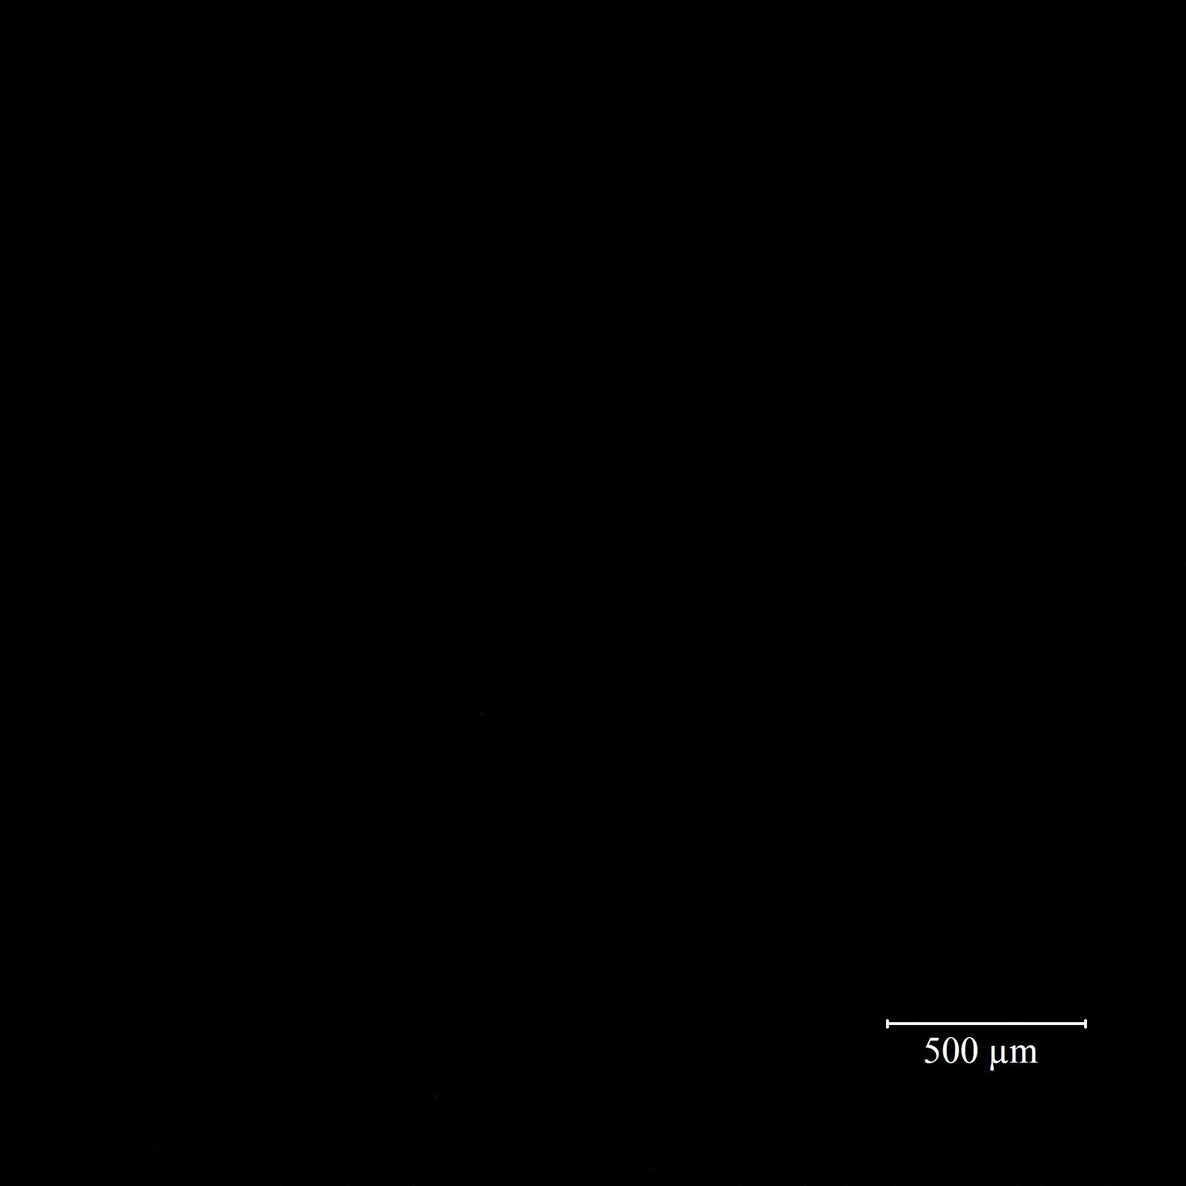

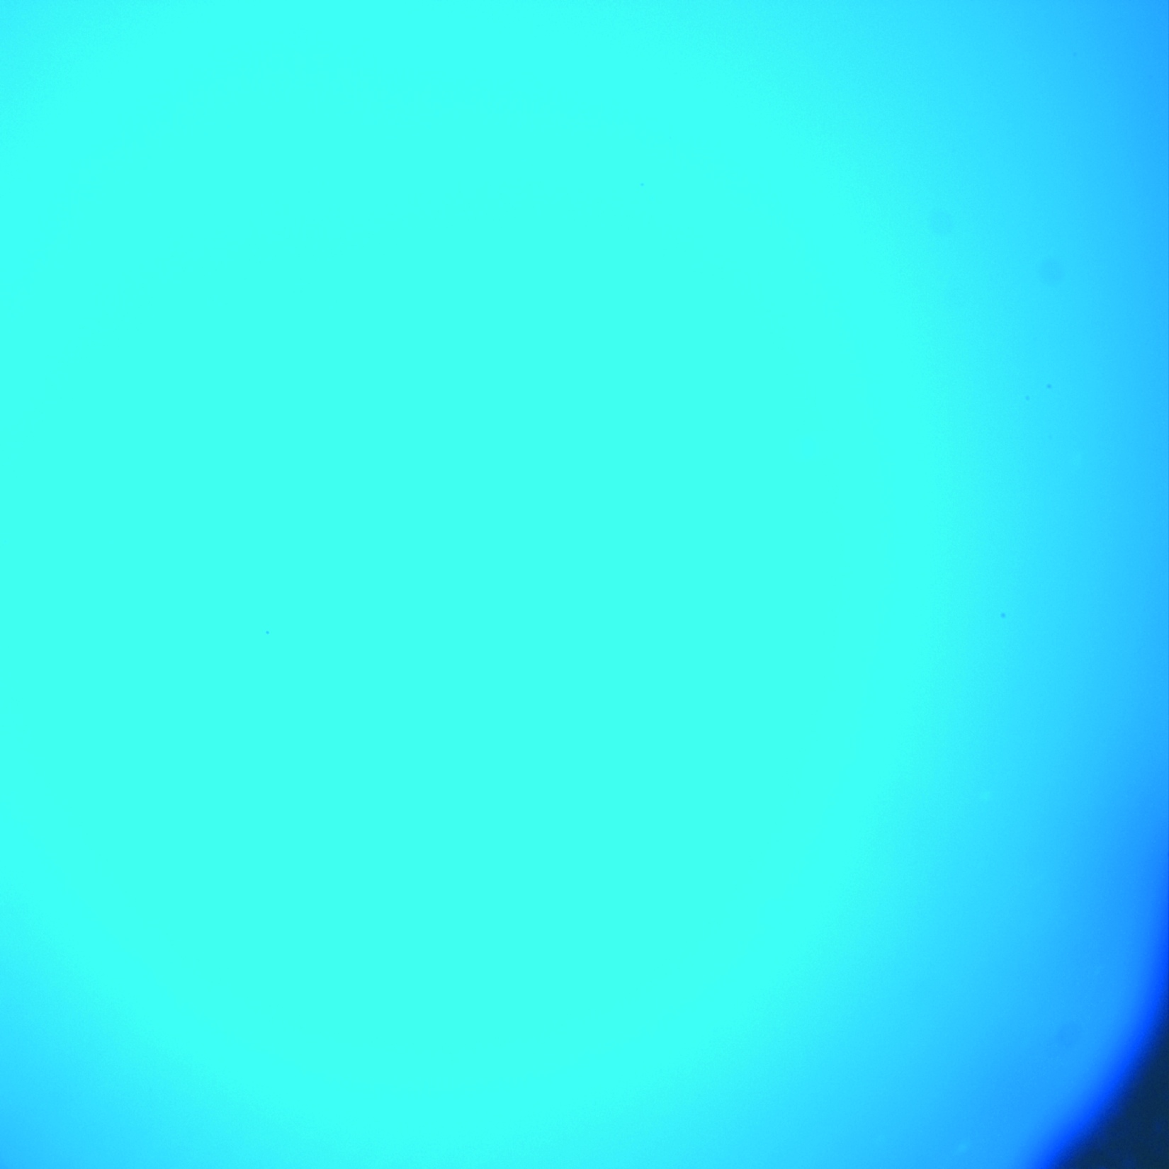
How do SNP work?
Before Clotting
.25 mg/mL SNP Solution
After Clotting
Notes:
This is a video of SNP at work in some human blood plasma. Also in the plasma is a special chemical that glows under UV light when a clot starts to form- the more brightly it glows, or fluoresces, the larger the clot. This video takes place over the course of just a few minutes, and you can clearly see the plasma start to glow. This means that the nanoparticle is doing its job.

Slide 15
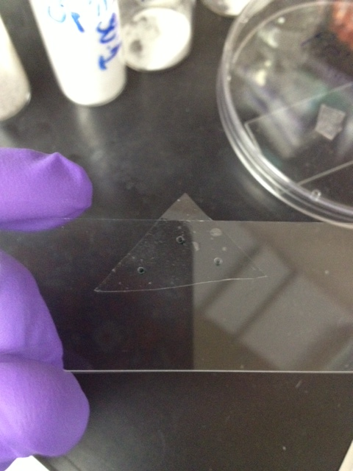
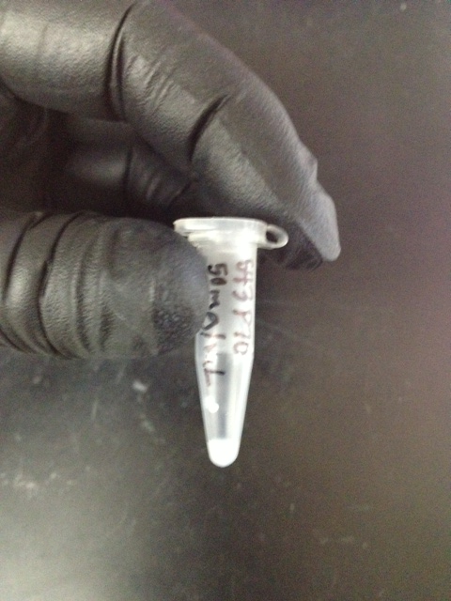
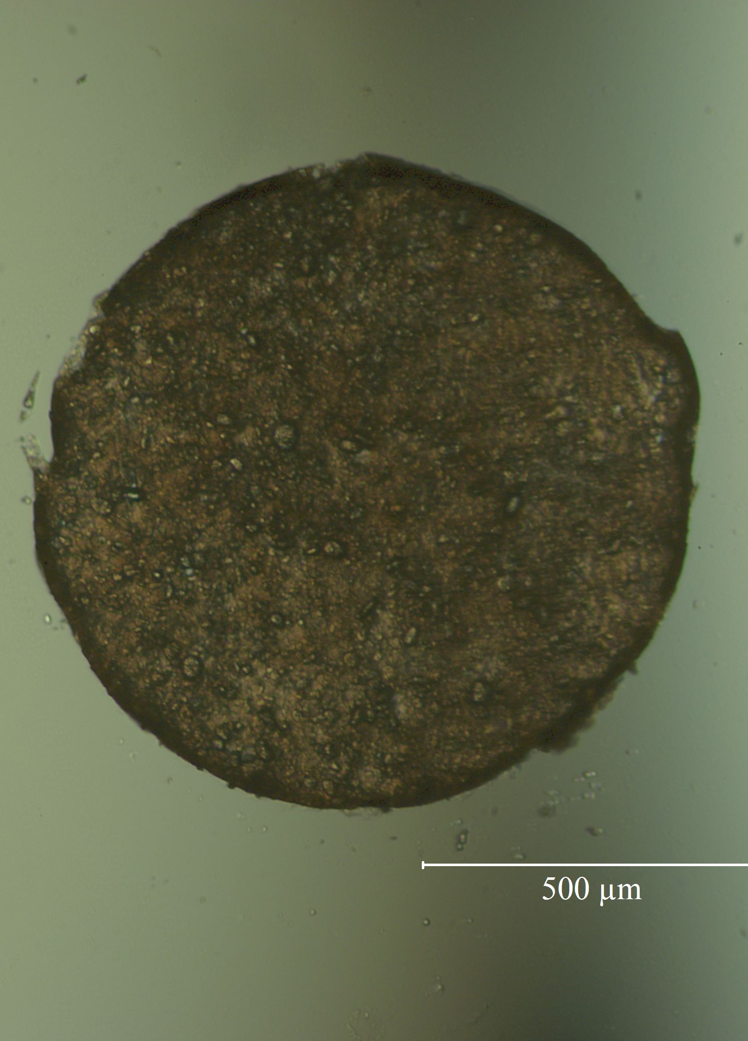
How do SNP Work?
Patch
Solution
Notes:
So the particle works, but researchers are still working on the best way to deliver the nanoparticle. Testing is taking place on both a “patch” form and a solution form, in which the particle is suspended in a liquid. Let’s take a look at both of these while we revisit the idea of surface area.

Slide 16
In Solution:
In Patch:
SNP
Notes:
Remember that surface area is one of the key features of nanoparticles. Nanoparticles are extremely small and therefore have tons and tons of surface area. In this case, that means tons and tons of negative surfaces are available to kick start that blood coagulation cascade. The more surfaces are exposed to the blood stream, the more effectively this nanoparticle can cause blood to clot. When suspended in a liquid, all the surfaces of these particles are exposed. This means lots of negative surfaces. In a patch form, however, the surfaces are squished together, essentially forming a larger particle with the same volume as all these nanoparticles, but much less surface area. Which one do you think would cause blood to clot more quickly? In your notebooks, write a claim that answers this question, and support it with evidence and reasoning.

Slide 17
Quickie Quiz 3
Which delivery system of the SNP will cause clotting more quickly- Solution or Patch?
Write a claim that answers this question and support it with evidence and reasoning.

Slide 18
Quickie Quiz 3- Answers
Surface area is key to the function of nanoparticles
Patched particles have less surface area that those in solution
Particles in solution will react more quickly and cause clotting.
72 Surfaces
26 Surfaces
Notes:
Slide 18:
Remember that surface area is one of the essential, unique characteristics that make nanoparticles so special and useful. More surface area means more exposed binding sites to cause a chemical reaction. In this case, particles in solution would have all surfaces exposed and available for reaction, while particles in a patch will only have the outer surfaces available. The inner particles will be hidden, thus making the surface area smaller than it would be if the particles were suspended. You’ll notice that in this picture, the suspended particles on the left have 72 available surfaces, while the patched particles on the right have only 26 available surfaces. This means that the SNP in solution will cause clotting more quickly than those in patch form.

Slide 19


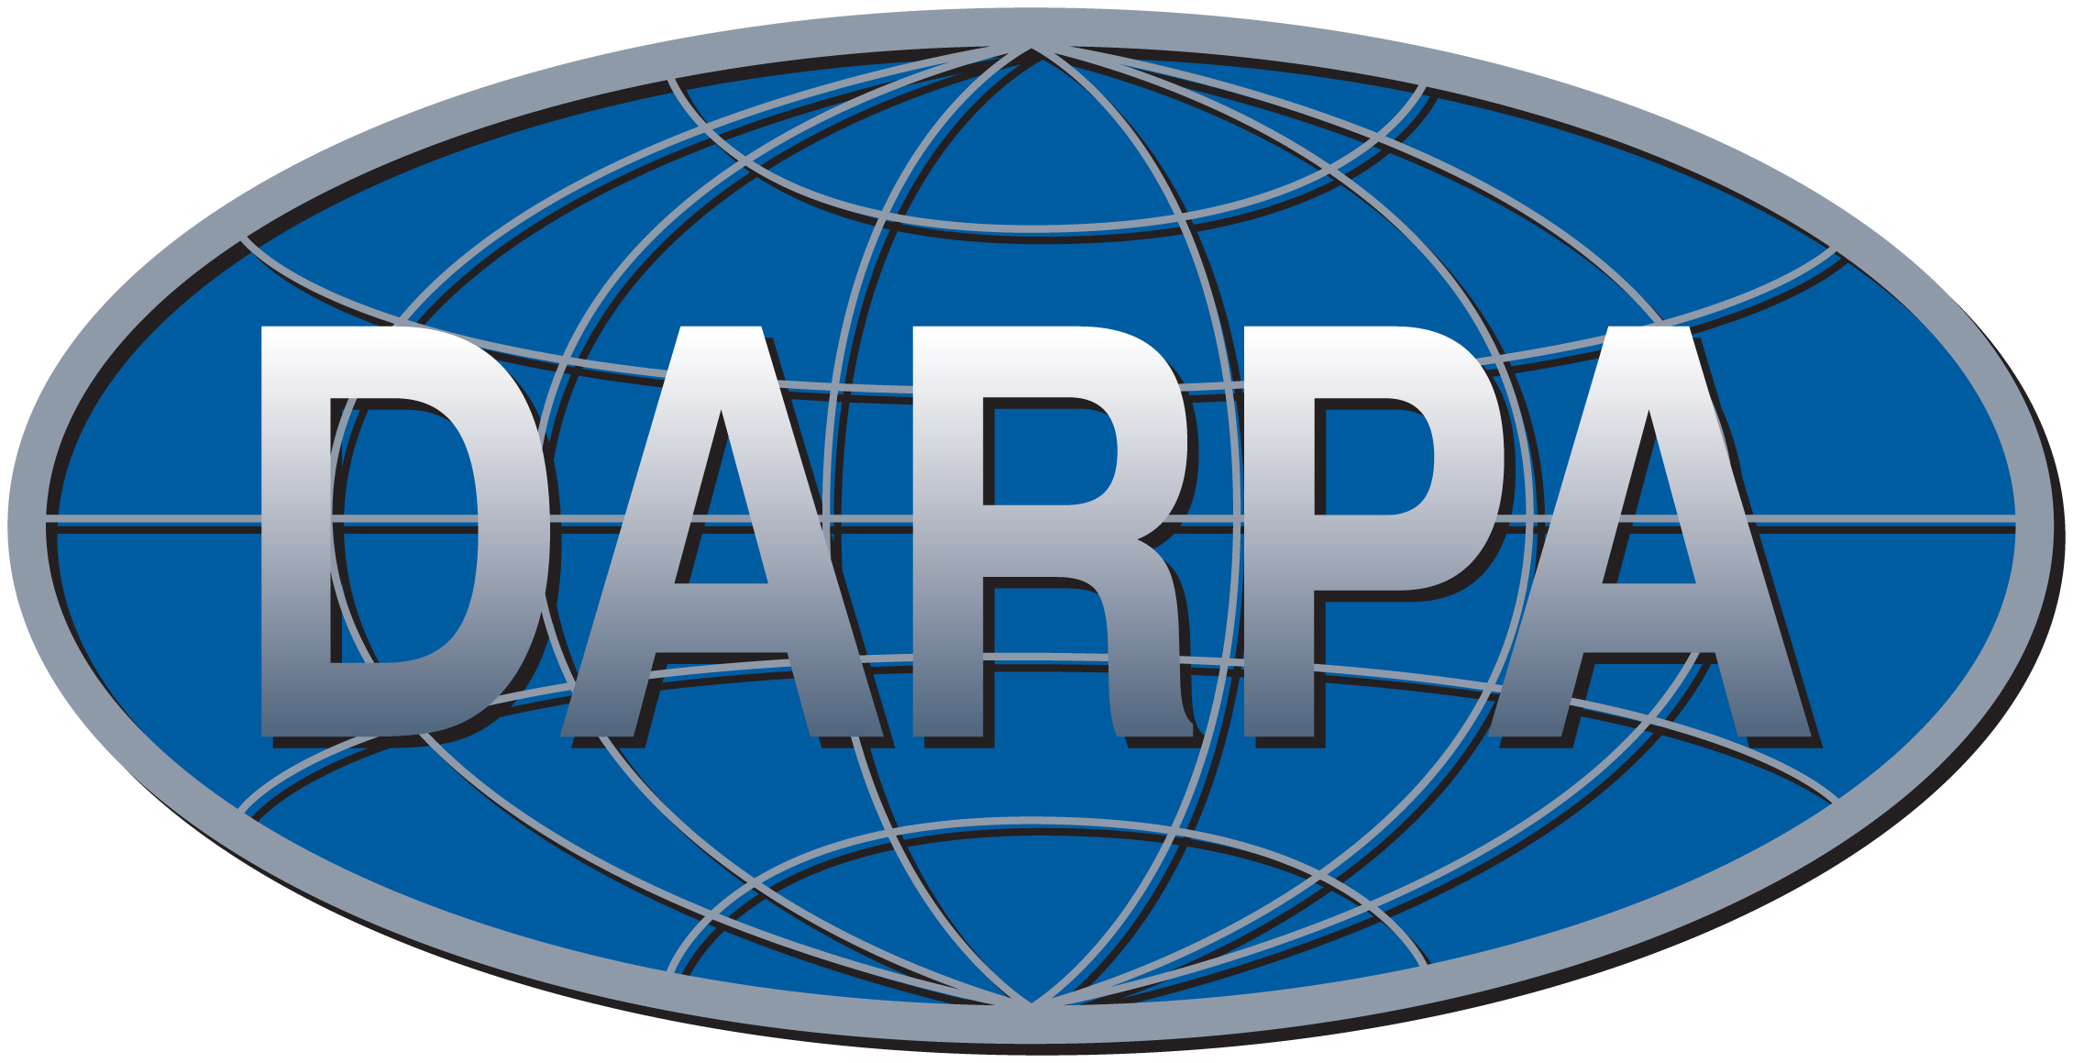

A Big Thanks to…
Tracy Chuong
Frank Kinnaman
Damien Kudela
Galen Stucky
MRL RET Program
Notes:
Now you have a pretty sophisticated knowledge of how nanoparticles can be used to help blood clot at the site of internal injuries, a very tricky dilemma. You also understand how surface area and size play key roles in the effectiveness of these nanoparticles in this application.
Lastly, I just want to thank some of the many people who helped inform me (and therefore you) about this exciting new application of nanotechnology.

